Slide 1
RNAseq pipeline: Individual Task
A
Pipeline for RNA-seq (e.g., JCI dataset: GSE198256)
B
Compare “Results from JCI Insight” vs “Results derived from my own analysis”
Azari I. Bantan

Slide 2
RNAseq pipeline: Individual Task
A
Pipeline for RNA-seq (e.g., JCI dataset: GSE198256)
B
Compare “Results from JCI Insight” vs “Results derived from my own analysis”
Azari I. Bantan

Slide 3


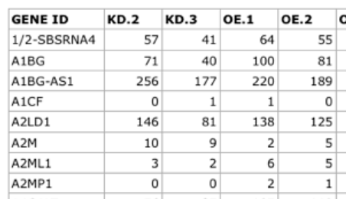
A
Pipeline for RNA-seq (e.g., JCI dataset: GSE198256)
Sequencing
QC
QC
QC
Downstream Analysis
Experimental Design
Library Prep.
Alignment
Quantification
Our focus! Explained in detail in the coming slides!
PCA
Quantification
QC: exploratory
Normalization
Differential expression
GSEA

Slide 4
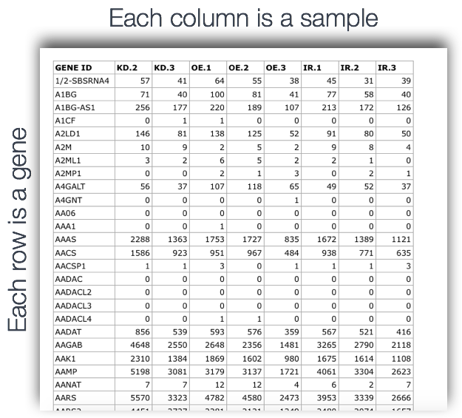
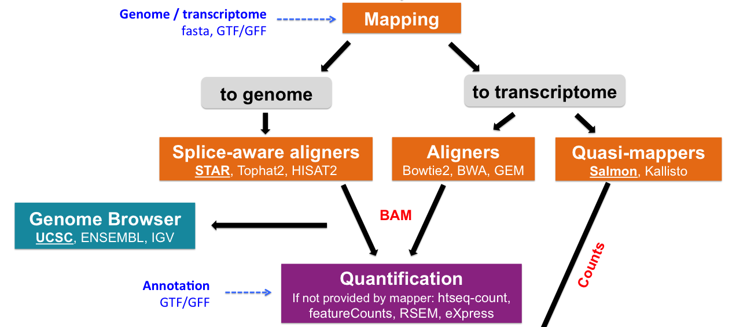
A
Pipeline for RNA-seq (e.g., JCI dataset: GSE198256)
PCA
Quantification
QC: exploratory
Normalization
Differential expression
GSEA
Genes Quantification
From here, we work with the count matrix
“Read Mapping”, Biocorecrg.Github.lo, 2022
https://hbctraining.github.io/Intro-to-rnaseq-hpc-O2/lessons/05_counting_reads.html

Slide 5
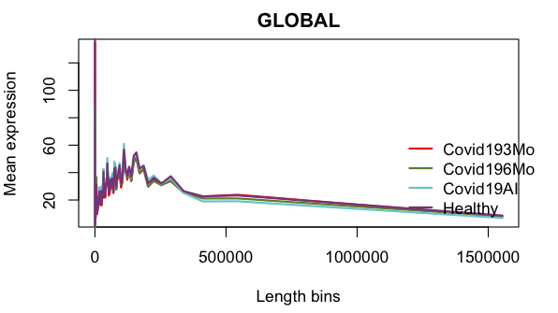
A
Pipeline for RNA-seq (e.g., JCI dataset: GSE198256)
PCA
Quantification
QC: exploratory
Normalization
Differential expression
NOISeq
GSEA
Examples:
Biotype detection
Sequencing depth & Expression Quantification
Sequencing bias detection
Feature length effect
GC content
Differences in RNA composition
Batch effect exploration

Slide 6
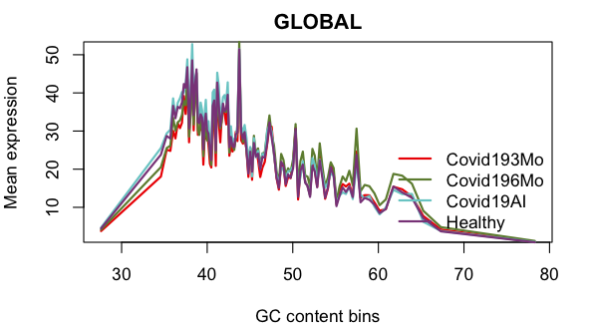
A
Pipeline for RNA-seq (e.g., JCI dataset: GSE198256)
PCA
Quantification
QC: exploratory
Normalization
Differential expression
NOISeq
GSEA
Examples:
Biotype detection
Sequencing depth & Expression Quantification
Sequencing bias detection
Feature length effect
GC content
Differences in RNA composition
Batch effect exploration

Slide 7
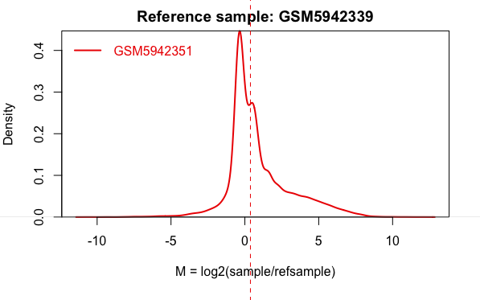
A
Pipeline for RNA-seq (e.g., JCI dataset: GSE198256)
PCA
Quantification
QC: exploratory
Normalization
Differential expression
NOISeq
GSEA
Examples:
Biotype detection
Sequencing depth & Expression Quantification
Sequencing bias detection
Feature length effect
GC content
Differences in RNA composition
Batch effect exploration

Slide 8

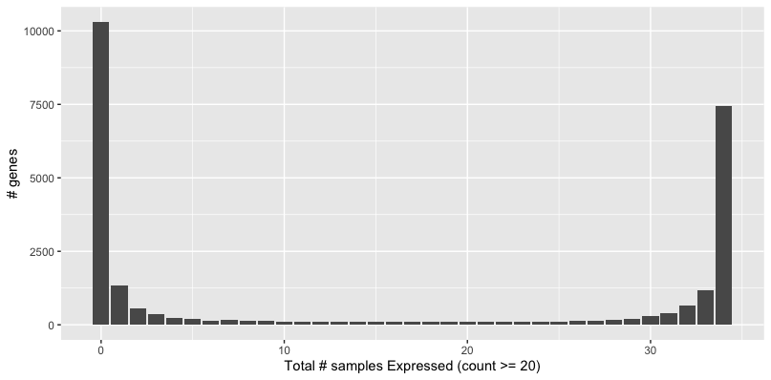
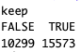
A
Pipeline for RNA-seq (e.g., JCI dataset: GSE198256)
PCA
Quantification
QC: exploratory
Normalization
Differential expression
Basic R
GSEA
Filtering out non/low-expressed genes:
Genes that are not expressed (or have very low expression)
Approach: We assume a gene is ‘expressed’ in a given sample if it has a count of => 20
We will decide to keep genes that are expressed in at least in 1 sample
keep <- rowSums(assay(dds) >= 20) >= 1
dds_f <- dds[keep,]
But there are also genes (either many or few) which are expressed in at least => 1 samples
Here, we can see that there are many genes which are not ‘expressed’
Filtered out ~18K genes
NB. Threshold decision was based on the ‘methods’ section in the JCI paper, to make results comparable later in the analysis

Slide 9
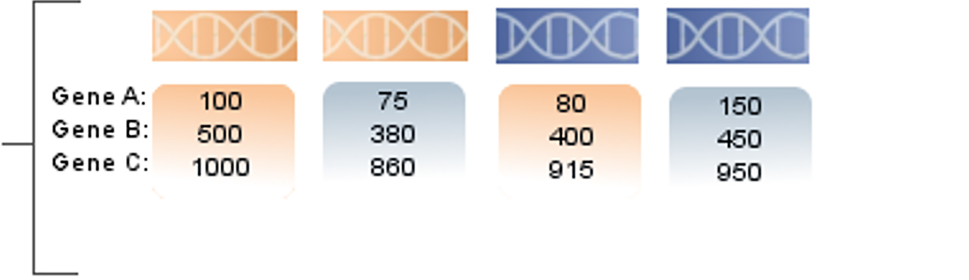
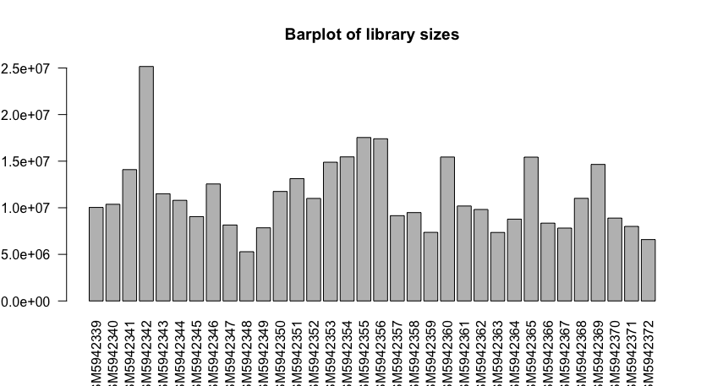
A
Pipeline for RNA-seq (e.g., JCI dataset: GSE198256)
PCA
Quantification
QC: exploratory
Normalization
Differential expression
DESeq2
GSEA
Read depth: Samples sequenced with more depth will have more reads mapping to each genes
Read length: Longer genes will have more reads mapping to them
Counts bias!
Median Ratio Normalization (MRN)
Similar to TMM
Allow for the comparison of absolute expression values between samples (hence, differential expression analysis)
Raw counts are divided by the total count of their sample, then averaged across all samples in a condition for a given gene
MRN method is applied in DESeq
estimateSizeFactors() → used for normalization

Slide 10
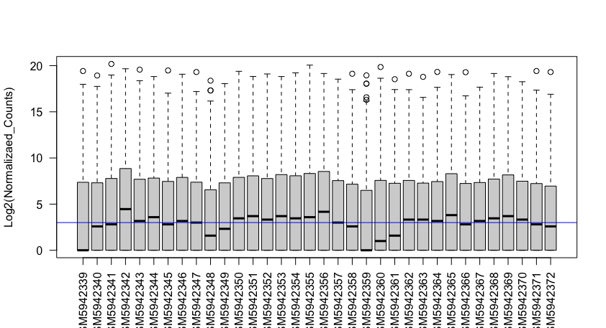
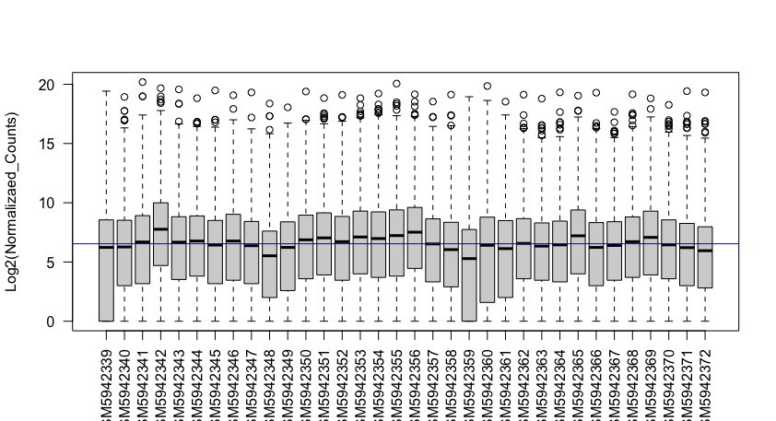
A
Pipeline for RNA-seq (e.g., JCI dataset: GSE198256)
PCA
Quantification
QC: exploratory
Normalization
Differential expression
DESeq2
GSEA
Median Ratio Normalization (MRN)
Similar to TMM
Allow for the comparison of absolute expression values between samples (hence, differential expression analysis)
Raw counts are divided by the total count of their sample, then averaged across all samples in a condition for a given gene
This method is applied in DESeq
estimateSizeFactors()
(A)
In the plots, we see that by applying MRN (B), it allows the data to center, hence the medians are relatively matched across the samples, as compared to (A).
(B)

Slide 11
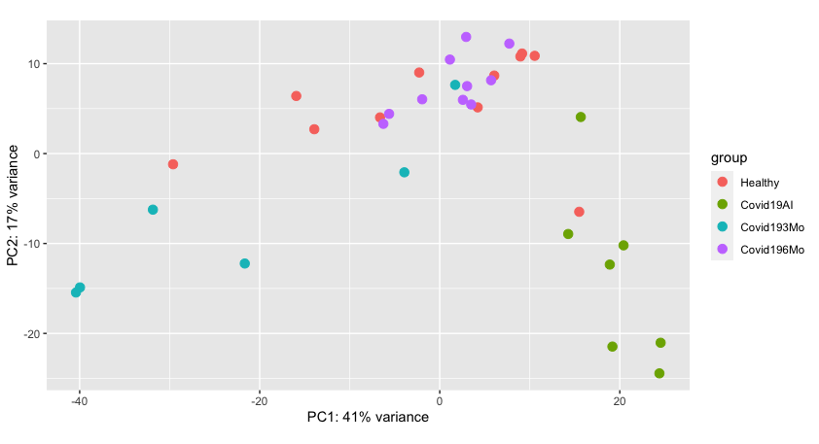
A
Pipeline for RNA-seq (e.g., JCI dataset: GSE198256)
PCA
DESeq2
Quantification
QC: exploratory
Normalization
Differential expression
GSEA
Principle component analysis (PCA)
PCA is dimensionality reduction method which aims to transform large set of variables (with high variation) into a smaller set using unsupervised algorithms.
Goal: observe patterns within a dataset and subsequently condense variables to their most significant features.
In the PCA plot, each point represents a sample (N=34), where Covid19AI (acute infection) samples seem to cluster distinctly away from the rest of sample groups, with high variance explained.

Slide 12
A
Pipeline for RNA-seq (e.g., JCI dataset: GSE198256)
PCA
Quantification
QC: exploratory
Normalization
Differential expression
DESeq2
GSEA
Differential Expression (DE) Analysis
Wald
Modelling
Shrinkage of log2FC
Test
Likelihood ration test (LRT)

Slide 13
A
Pipeline for RNA-seq (e.g., JCI dataset: GSE198256)
PCA
Quantification
QC: exploratory
Normalization
Differential expression
DESeq2
GSEA
Differential Expression (DE) Analysis
Wald
Modelling
Shrinkage of log2FC
Test
Likelihood ration test (LRT)
Design formula:
dds_f <- DESeqDataSetFromMatrix(countData=GSE198256_count, colData=Factors_GSE198256, design=~Group)
So that DESeq2 will test the effect of the Group for differential expression
Differential expression analysis based on the Negative Binomial Distribution:
GSE198256_DESeq <- DESeq(dds_f)

Slide 14
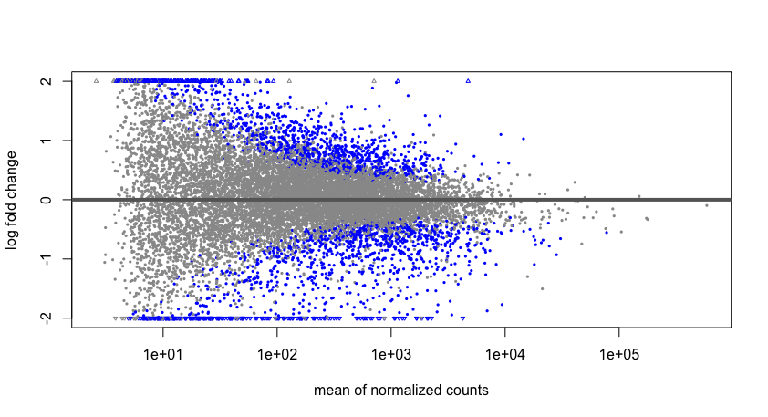
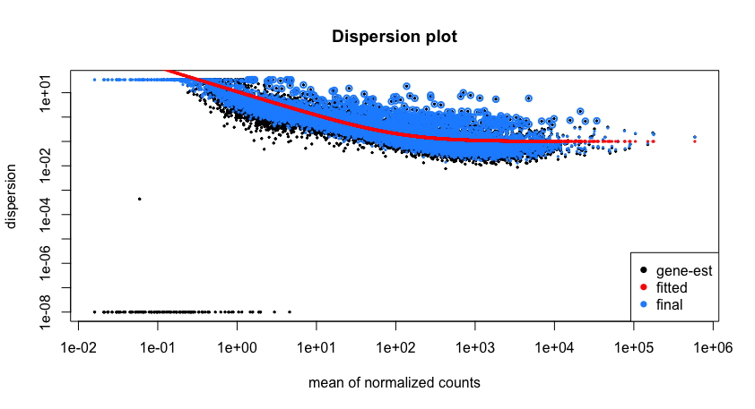
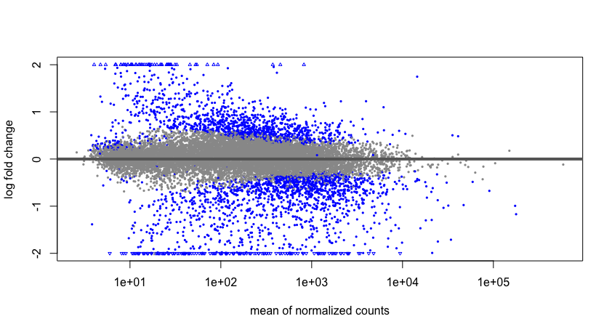
A
Pipeline for RNA-seq (e.g., JCI dataset: GSE198256)
PCA
Quantification
QC: exploratory
Normalization
Differential expression
DESeq2
GSEA
Differential Expression (DE) Analysis
Wald
Modelling
Shrinkage of log2FC
Test
Likelihood ration test (LRT)
Estimate dispersion for each gene
Fitting curve to gene-wise dispersion estimates
Shrinkage of dispersion
Shrinkage of log2FC
“Higher dispersion at low mean expression!”

Slide 15
A
Pipeline for RNA-seq (e.g., JCI dataset: GSE198256)
PCA
Quantification
QC: exploratory
Normalization
Differential expression
DESeq2
GSEA
Differential Expression (DE) Analysis
Wald
Modelling
Shrinkage of log2FC
Test
Likelihood ration test (LRT)
Differential expression analysis based on the Negative Binomial Distribution + apply test
GSE198256_DESeq <- DESeq(dds_f, test = c("Wald", "LRT"))
Both are performed on parameters that have been estimated by maximum likelihood

Slide 16
A
Pipeline for RNA-seq (e.g., JCI dataset: GSE198256)
PCA
Quantification
QC: exploratory
Normalization
Differential expression
DESeq2
GSEA
Differential Expression (DE) Analysis
Wald
Modelling
Shrinkage of log2FC
Test
Likelihood ration test (LRT)
Wald Test: Only estimates one model per gene and evaluates the null hypothesis that LFC == 0.
wald_dss <- DESeq(dds_f, test = "Wald")

Slide 17
A
Pipeline for RNA-seq (e.g., JCI dataset: GSE198256)
PCA
Quantification
QC: exploratory
Normalization
Differential expression
DESeq2
GSEA
Differential Expression (DE) Analysis
Wald
Modelling
Shrinkage of log2FC
Test
Likelihood ration test (LRT)
LRT: Two models are estimated per gene; the fit of one model is compared to the fit of the other model
LRT_dss <- DESeq(dds_f, test = "LRT”, reduced = ~1)
Since our ‘full’ model only has one factor (Group), the ‘reduced’ model is just the intercept (~ 1).

Slide 18
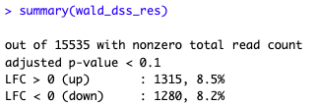
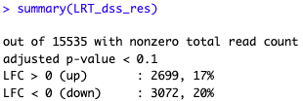
A
Pipeline for RNA-seq (e.g., JCI dataset: GSE198256)
PCA
Quantification
QC: exploratory
Normalization
Differential expression
DESeq2
GSEA
Differential Expression (DE) Analysis
Wald
Modelling
Shrinkage of log2FC
Test
Likelihood ration test (LRT)
Wald Test
LRT
One can also filter based on lfc:
summary(results(wald_dss, alpha = 0.01, lfcThreshold = 0.58))

Slide 19
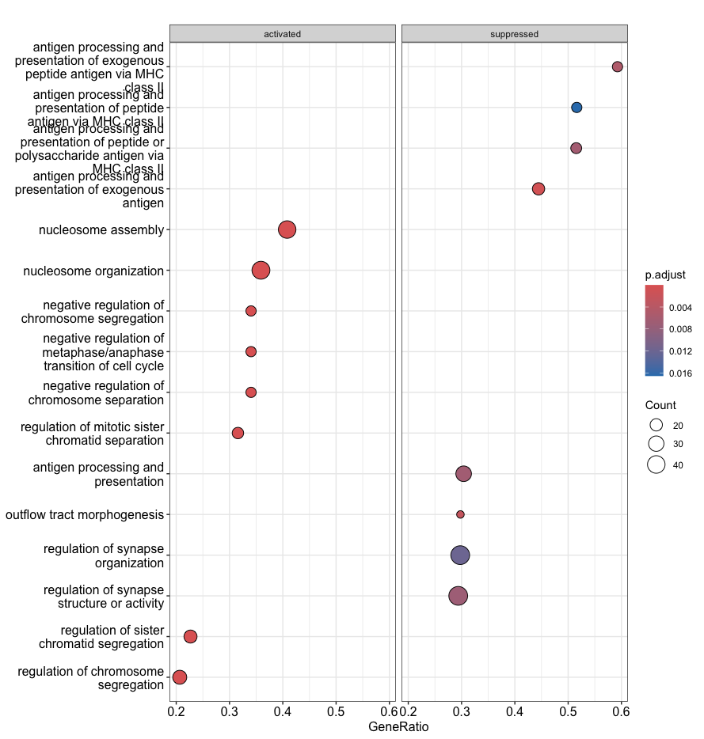
A
Pipeline for RNA-seq (e.g., JCI dataset: GSE198256)
PCA
Quantification
QC: exploratory
Normalization
Differential expression
DESeq2
GSEA
GSEA: Functional profiling – biological interpretation
Using differentially expressed genes (DEGs) using the following contrast (Acute infection vs Healthy):
dds_a <- DESeq(dds_f)
contrast <- c("Group", "Covid19AI", "Covid193Mo")
result_acute_vs_early <- results(dds_a, contrast = contrast)

Slide 20
RNAseq pipeline: Individual Task
A
Pipeline for RNA-seq (e.g., JCI dataset: GSE198256)
B
Compare “Results from JCI Insight” vs “Results derived from my own analysis”

Slide 21
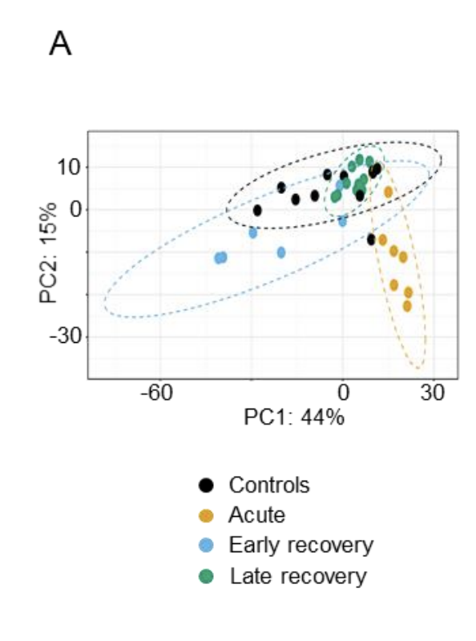
B
Compare “Results from JCI Insight” vs “Results derived from my own analysis”
Key results:
A clear separation between samples from acute and healthy controls upon principal component analysis
My analysis:
(A) PCA plot representing the distinct clusters based on transcriptional profiles of monocytes from controls (n = 11), acute infection (n = 7), “early recovery” (days 56 to 120 post symptoms onset, n = 6) and “late recovery” phases (days 160 to 268 post symptoms onset, n = 10).
Similar outcome of clustering is observed with respect to ‘Groups’, showing relatively the same variance explained

Slide 22
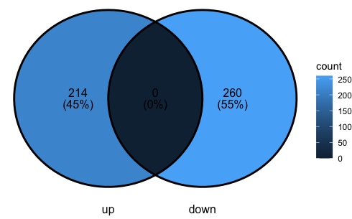
B
Compare “Results from JCI Insight” vs “Results derived from my own analysis”
Key results:
In acute samples, we identified 339 statistically differentially expressed genes (DEG: 184 up- and 155 downregulated genes compared to controls, with a fold change (FC) > 2 and a false discovery rate (FdR) <0.05, Figure 6B)
My analysis:
#### Acute vs Healthy
dds_a <- DESeq(dds_f)
contrast <- c("Group", "Covid19AI", "Healthy")
result_acute_vs_healthy <- results(dds_a, contrast = contrast)
result_acute_vs_healthy_f_up <- subset(result_acute_vs_healthy, padj < 0.05 & log2FoldChange < 2)
result_acute_vs_healthy_f_down <- subset(result_acute_vs_healthy, padj < 0.05 & log2FoldChange < -2)
DEG for Covid19AI vs Healthy:
214 up- and 260 downregulated genes

Slide 23
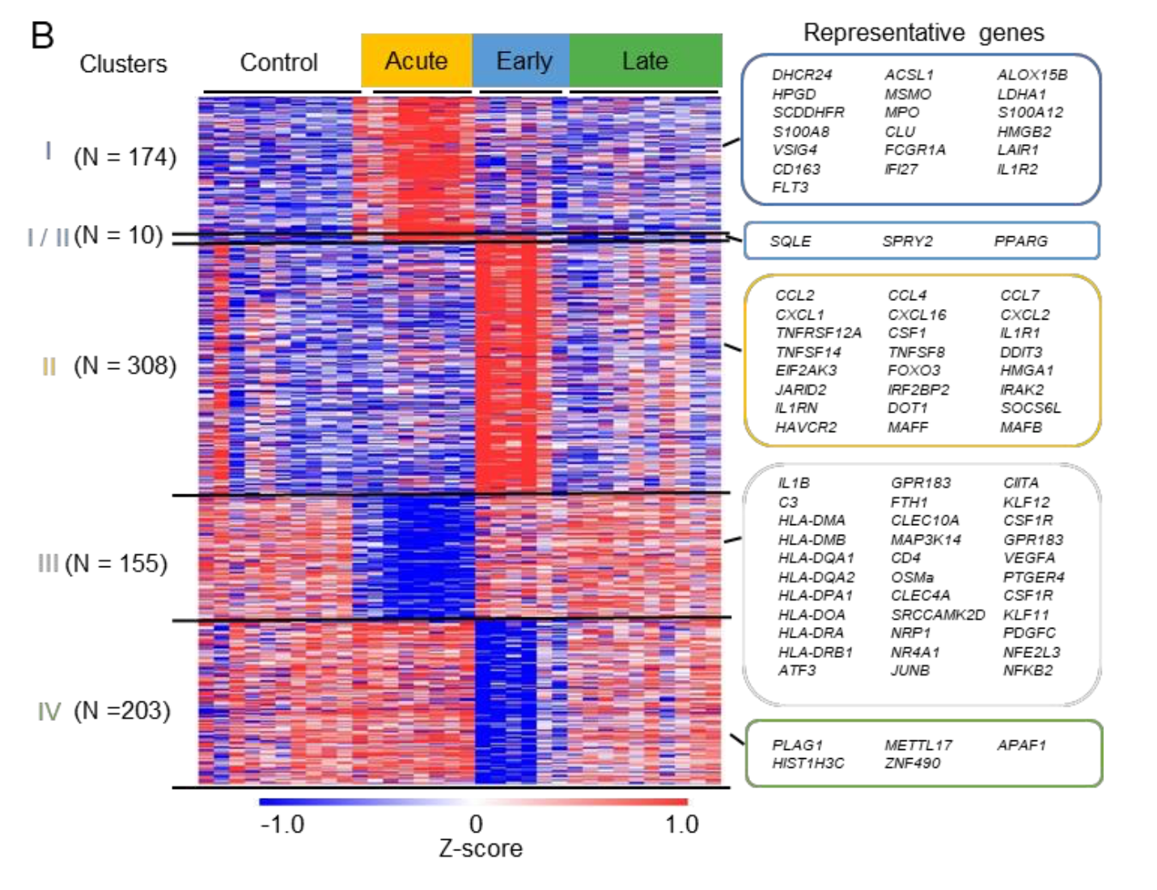

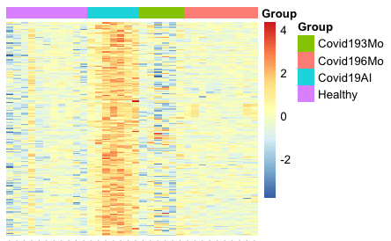
B
Compare “Results from JCI Insight” vs “Results derived from my own analysis”
Key results:
In acute samples, we identified 339 statistically differentially expressed genes (DEG: 184 up- and 155 downregulated genes compared to controls, with a fold change (FC) > 2 and a false discovery rate (FdR) <0.05, Figure 6B)
My analysis:
(B) Heatmap of differential genes for controls (n = 11), acute infection (n = 7), “early recovery” (n = 6) and “late recovery” phases (n = 10), representative genes were selected.
Here, I plotted only genes which are upregulated in acute compared to COVID193Mo (early)

Slide 24
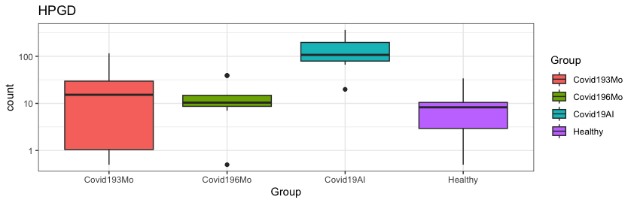
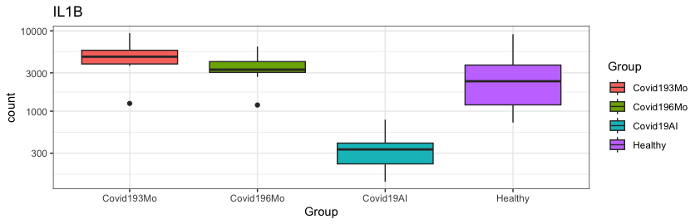
B
Compare “Results from JCI Insight” vs “Results derived from my own analysis”
Key results:
Example: Testing for known genes…
3248 (HPGD) → up-regulated in Covid19 acute infection
3553 (IL1B) → down-regulated in Covid19 acute infection
My analysis:

